Slide 1
MEDI-CAPS UNIVERSITY
Project Topic :- Virtual voice assistant
PHASE – 2ND
GUIDED BY – RAJESH KHARCHE
CREATED BY – DEEPESH BARDE
VISHAL CHOUDHARY

Slide 2
CONTENT
STRUCTURED SYSTEM ANALYSIS
SYSTEM DESIGN
TOOLS USED AND DESCRIPTIONS

Slide 3
INTRODUCTION
This Voice recognition technology is evolving rapidly and is expected to become not only the default input form for smartphones, but also for cars and other home appliances such as TV and fridge. Due to the unique features associated with voice input, including an implicit verbalization of commands, privacy and acceptability issues may affect the usage and adoption of voice-bases.
Several researchers have been interested in the recognition of human activities in recent years. In this project, we propose a voice recognition system that recognizes human activities through a deep learning algorithm. Voice is essentially a mode of communication that lets users communicate with each other. Voice Recognition, also known as Automatic Speech Recognition (ASR), identifies spoken words and phrases and translates them to a readable computer format. It takes the input of the user in the form of a voice or text and processes it and returns the feedback in different ways, such as the action to be done or the search result to the end user. Hence, there is also the additional challenge of making out spoken words from noise in the audio. Modern mobile technology has been very useful to consumers as it provides consumers with access to various apps and resources from anywhere in the world. Some of the most used mobile Operating Systems are Android, Apple, Windows,
Blackberry, etc. These Operating System provides different services to the user. Most systems allow the user to train the software to understand their voice so that it can translate speech to text more precisely. Google has created "Google Assistant" and iPhone has created "Siri" to help users respond to their voice commands in an effective manner. Mobile App Voice Assistant helps users to communicate with AI in a very meaningful way. Mobile App Voice Assistant helps users to communicate with AI in a very meaningful way. In using natural language processing and machine learning, Amazon's Echo app has enhanced the engagement of individuals with AI technology.

Slide 4
STRUCTURED SYSTEM ANALYSIS
Structured systems analysis is a specific technique for systems analysis that covers all activities from initial understanding of the problem through to specification and high-level design of the software system.
So in our case
Considering overall research, voice application will be used in following three ways: Firstly, command to the computer whereas secondly, to input information the computer, finally for communication with other people. In this section we will be discussing general components for voice application

Slide 5

End user
Front end Interfaces
Dictionary and text file DB
Voice recognition system
General structure

Slide 6
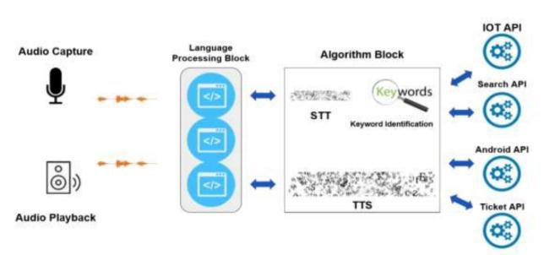
System Architecture The total design consists of these phases:
Collection of data which is in speech format.
Analyse the voice and convert it to text.
storing the data and processing it.
Speech generation from the text output that is processed

Slide 7
SYSTEM DESIGN
Initially, the system is in idle mode. As it receives any wake up call it begins execution.
The received command is identified whether it is a questionnaire or a task to be performed. Specific action is taken accordingly. After the Question is being answered or the task is being performed, the system waits for another command. This loop continues unless it receives quit command. At that moment, it goes back to sleep.

Slide 8
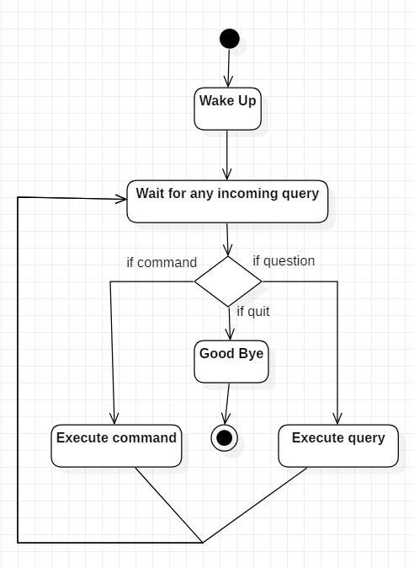
ACTIVITY DIAGRAM

Slide 9
DATA FLOW DIAGRAM
Virtual Assistant
User
Send request
Receives Response
DFD Level 0

Slide 10
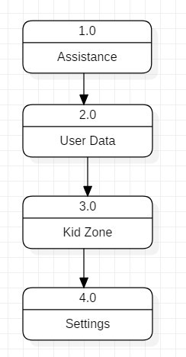
DFD Level 1

Slide 11
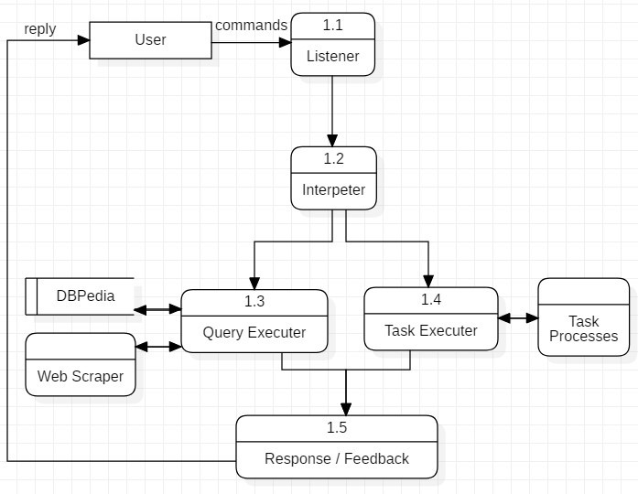
DFD Level 2
Data Flow in Assistance

Slide 12
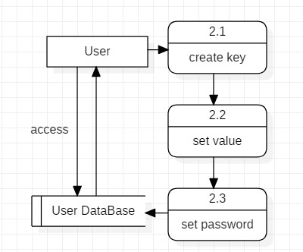
DFD Level 2
Managing User Data

Slide 13
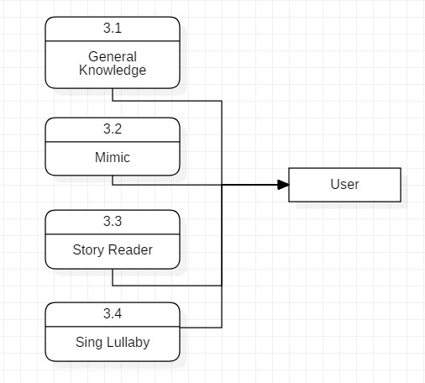
DFD Level 2
Data Flow in Kid Zone

Slide 14
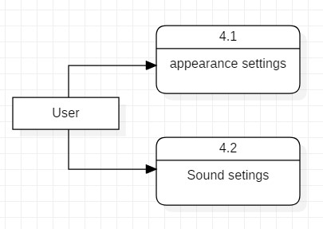
DFD Level 2
Settings of virtual Assistant

Slide 15
Tools used and descriptions
Python
Python is an OOPs (Object Oriented Programming) based, high level, interpreted programming language. It is a robust, highly useful language focused on rapid application development (RAD). Python helps in easy writing and execution of codes. Python can implement the same logic with as much as 1/5th code as compared to other OOPs languages.
Python provides a huge list of benefits to all. The usage of Python is such that it cannot be limited to only one activity. Its growing popularity has allowed it to enter into some of the most popular and complex processes like Artificial Intelligence (AI), Machine Learning (ML), natural language processing, data science etc. Python has a lot of libraries for every need of this project. For LUCY, libraries used are speech recognition to recognize voice, Pyttsx for text to speech, selenium for web automation etc.

Slide 16
PyCharm
PyCharm is an integrated development environment used in computer programming, specifically for the Python programming language. It is developed by the Czech company JetBrains.
Pyttsx3
Pyttsx3 stands for Python Text to Speech. It is a cross-platform Python wrapper for text to-speech synthesis. It is a Python package supporting common text-to-speech engines on Mac OS X, Windows, and Linux. It works for both Python2.x and 3.x versions. Its main advantage is that it works offline.

Slide 17
Speech Recognition
This is a library for performing speech recognition, with support for several engines and APIs, online and offline. It supports APIs like Google Cloud Speech API, IBM Speech to Text, Microsoft Bing Voice Recognition etc.
Smtplib
The smtplib is a Python library for sending emails using the Simple Mail Transfer Protocol (SMTP). The smtplib is a built-in module; we do not need to install it. It abstracts away all the complexities of SMTP.
PyAutoGUI
PyAutoGUI is a cross-platform GUI automation Python module for human beings. Used to programmatically control the mouse & keyboard.

Slide 18
Wikipedia is a Python library that makes it easy to access and parse data from Wikipedia.
Search Wikipedia, get article summaries, get data like links and images from a page, and more. Wikipedia wraps the MediaWiki API so you can focus on using Wikipedia data, not getting it.
pywhatkit is a python module for sending WhatsApp messages at a certain time. To install the pywhatkit module, Type the following command in your IDE/Compiler: pip install pywhatkit. This command will download the pywhatkit module. It will cause some delay as it will download some related modules too

Slide 19
Conclusion
Voice-Controlled Devices uses Natural Language Processing to process the language spoken by the human and understand the query and process the query and respond to the human with the result. The understanding of the device means Artificial Intelligence needs to be integrated with the device so that the device can work in a smart way and can also control IoT applications and devices and can also respond to query which will search the web for results and process it. It is designed to minimize the human efforts and control the device with just human Voice. The device can also be designed to interact with other intelligent voice-controlled devices like IoT applications and devices, weather reports of a city from the Internet, send an email to a client, add events on the calendar, etc. The accuracy of the devices can be increased using machine learning and categorizing in any future development for startup , the queries in particular result sets and using them in further queries. The accuracy of the devices is increasing exponentially in the last decade. In future development we can make it to accept commands in bilingual language and respond back in the same language queried by the user. This can also be designed to help visually impaired people.

Slide 20
THANK YOU

